Slide 1

Thesis Topic: Optimizing Distributed Tracing and Telemetry in Microservices Using OpenTelemetry.
Name: Md Nur Mohammad
Masters in Communication systems and Networks at TH Köln
Student ID: 11145131
Supervisor:
EL Hussien Habib
Observability Site Reliability Engineer @Trivago

Slide 2
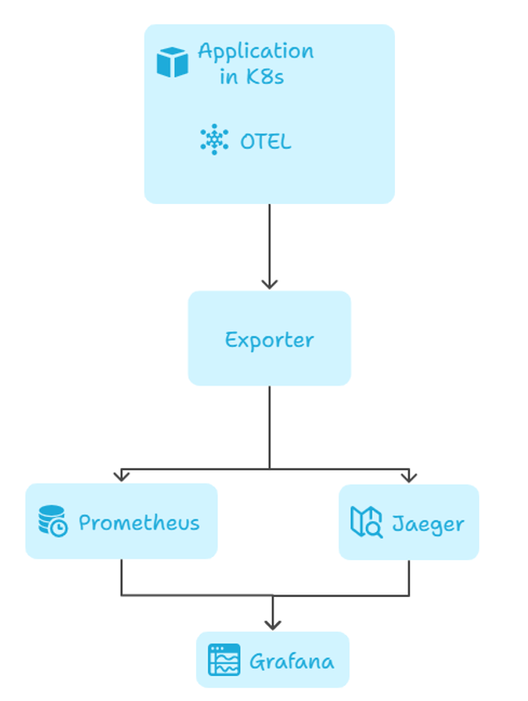
Workflow Diagramm

Slide 3
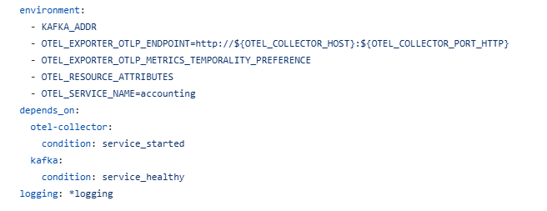
Otel Collecto in docker-compose.yaml
In Accounting service

Slide 4
environment:
Defines environment variables for the container (likely a service like accounting) to control its telemetry export behavior:
KAFKA_ADDR:
Used to connect to the Kafka broker (e.g., for log or event forwarding).
OTEL_EXPORTER_OTLP_ENDPOINT=http://${OTEL_COLLECTOR_HOST}:${OTEL_COLLECTOR_PORT_HTTP}:
Sets the OTLP endpoint where telemetry data is sent — in this case, the OpenTelemetry Collector via HTTP.
OTEL_EXPORTER_OTLP_METRICS_TEMPORALITY_PREFERENCE:
Configures how metrics are exported (e.g., cumulative or delta), affecting how Prometheus/Grafana visualizes the metrics.
OTEL_RESOURCE_ATTRIBUTES:
Allows you to define custom resource attributes (e.g., deployment.environment=prod) attached to all telemetry data.
OTEL_SERVICE_NAME=accounting:
Identifies the telemetry data's source service (in this case, accounting).

Slide 5
Depends_on Logging
depends_on:
Controls startup order and health checks for dependencies:
otel-collector:
condition: service_started → Waits until the OpenTelemetry Collector has started.
kafka:
condition: service_healthy → Waits until Kafka passes its health check before starting this service.
logging: *logging
Uses an anchor (*logging) to apply a predefined logging configuration.
Typically defined elsewhere in the Docker Compose file using &logging.

Slide 6
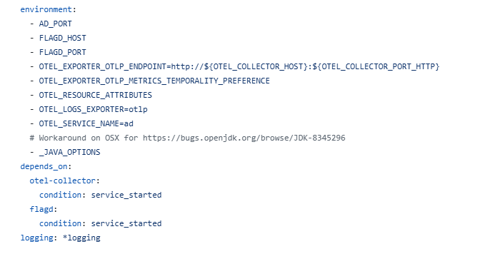
Otel Collecto in docker-compose.yaml
In adService

Slide 7
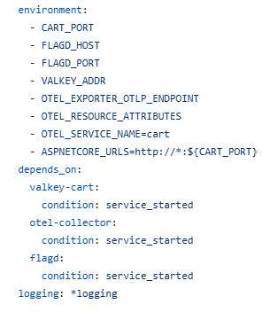
Otel Collecto in docker-compose.yaml
In Cart Service

